Slide 1

FLIGHT FARE PRICE PREDICTION USING MACHINE LEARNING
GUIDE
Ishita Nigam (EN18CS3011)
HITESH KAG
Luckyraj Singh Bais (EN19CS3L1011)
H Hritik Shrivastava (EN18CS301102)

Slide 2
INTRODUCTION
Since flight fare strategy has developed into a complex structure of sophisticated rules and mathematical models that drive the pricing strategies of airfare 1 2 3 although still largely held in secret studies have found that these rules are widely known to be affected by a variety of factors 4 5 traditional variables such as distance although still playing a significant role are no longer the sole factor that dictate the pricing strategy elements related to economic marketing and societal trends have played increasing roles in dictating the airfare prices.
Most studies on transportation worth prediction have targeted on either the national level or a selected market analysis at the market phase level, however, remains terribly restricted. We define the term market phase because the market/airport try between the flight origin and also the destination having the ability to predict the transportation trend at the particular market phase level is crucial for airlines to regulate strategy and resources for a specific route.

Slide 3
PROBLEM STATEMENT
The business enterprise business is dynamical quick and this is often attracting tons a lot of travellers every year. The airline business is taken into account mutually of the foremost subtle business in victimization advanced valuation ways. Now-a-days flight costs area unit quite unpredictable. The price ticket costs amendment often. Customer’s area unit seeking to induce the bottom value for his or her price ticket, whereas airline corporations try to stay their overall revenue as high as attainable victimization technology it's truly attainable to cut back the uncertainty of flight costs thus here we are going to be predicting the flight costs victimization economical machine learning techniques

Slide 4
LITRATURE REVIEW
It is troublesome for a client to receive a cheap airline ticket. For this, some procedures are investigated so as to assess the simplest time and date to shop for cheap airline tickets. The majority of those systems build use of Machine Learning, a contemporary processed technique. Gini and Groves [1] used Partial Least sq. Regression (PLSR) to create a model to determine the simplest time to shop for a flight price ticket. From February twenty second to Gregorian calendar month twenty third, 2011, knowledge was gathered from major journey travel booking sites further knowledge was collected further, that was wont to verify the similarities between the previous model's exhibitions Janssen [2] used the Linear Quantile blending Regression technique to make a desire model for the city to the big apple course, where www.infare.com provides daily airfares. The model is designed mistreatment 2 features: the quantity of days for departure and

Slide 5
Lwhether or not the departure is on a weekend or weekday. The model forecasts fare months prior to time. However, during a situation involving a protracted time commitment, the model fails to steer, and therefore the departure date is pushed back.

Slide 6
METHOD

Slide 7
❏ Data Collection
Since the APIs by Indian companies like Goibibo returned data in a complex format resulting in a lot of time to clean the data before analysing, therefore we decided to build a web spider that extracts the required values from a website and stores it as a CSV file. We decided to scrape travel service providers website using a manual spider made in Python. Further we also developed a Python script to run the API provided by Google flights which is more reliable, but it allows only 50 queries each day.
Such scrapping returns numerous variables for each flight returned and we had to decide the parameters that might be needed for the flight prediction algorithm. Not all are required and thus we selected the following –

Slide 8
Origin City
Destination City
Departure Date
Departure Time
Arrival Time
Total Fare
Airway Carrier
Duration
Class Type - Economy/Business
Flight Number
Hopping - Boolean
Taken Date - date on which this data was collected

Slide 9
Data Cleaning
The data was further processed based on the parameters mentioned below and cleaned based on appropriate considerations -
Days to Departure
Day of Departure
Duration
Hopping
Holiday
Outliers

Slide 10
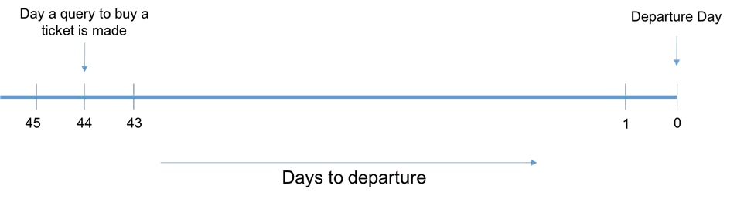
❏ Data Preparation Data preparation was a critical part, as we had multiple airlines on a specific day and we had to predict the future prices for all those airlines, or the airline which would have the lowest fare.

Slide 11
DATA BASE DESIGN

Slide 12
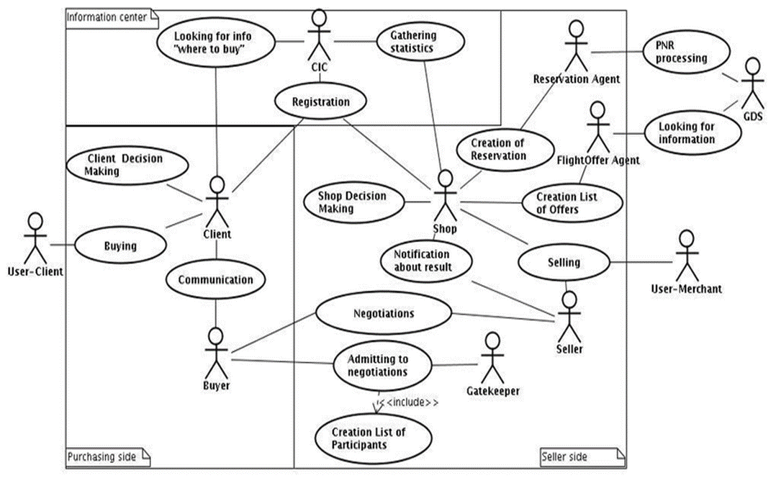
USE CASE DIAGRAM

Slide 13
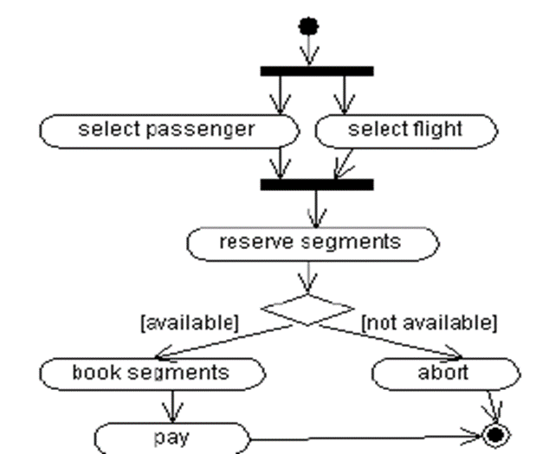
ACTIVITY DIAGRAM

Slide 14
RESULT
❏ In detailed analysis for the Delhi - Guwahati Route
The trends in the data collected for the sector of Delhi to Guwahati busted some of the very famous myths assumed by travellers of the aviation industry.
1. Flight prices do not increase continuously as the Date of Departure approaches closer.

Slide 15
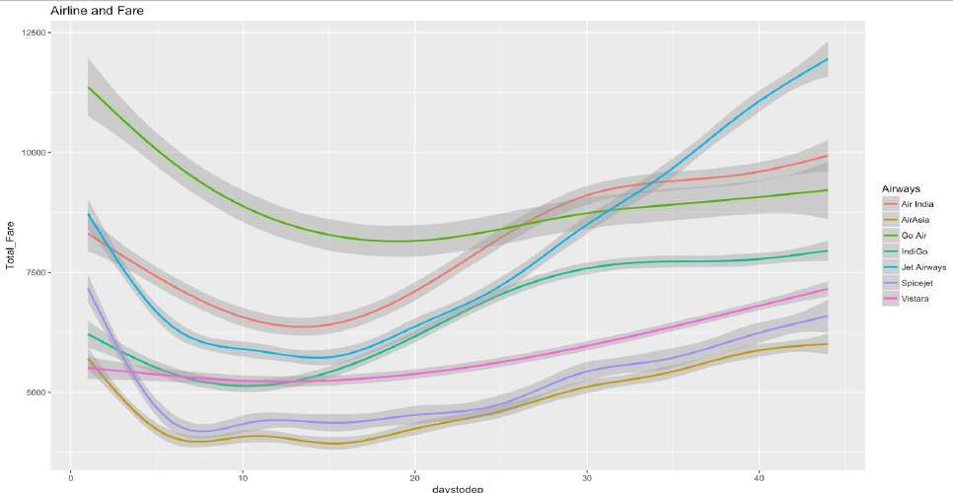

Slide 16
With the validation of the problem statement and with a scope to predict when to buy and when to wait, we begin the analysis of the dataset.
The dataset of the flight prices follows a Lognormal distribution with some outliers which have been ignored as we are only interested with the minimum fare corresponding to a certain route.

Slide 17
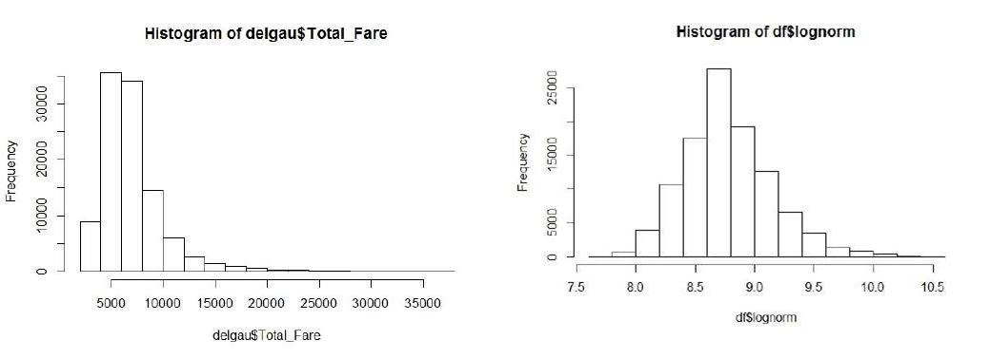

Slide 18
Statistically, the data transformed into lognormal distribution showed a significance level of 1, with skewness and kurtosis falling within the acceptable range for it to be considered a valid transformation.
Further, the trend of all airlines have been customly combined to form a trend used in the prediction of the model. The trend is significantly different for each day and thus different combined trends have been formulated corresponding to the day of the week.

Slide 19
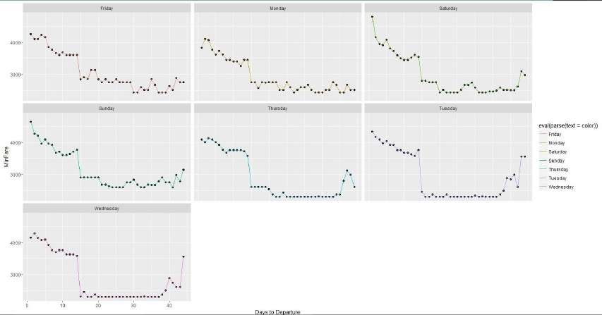

Slide 20
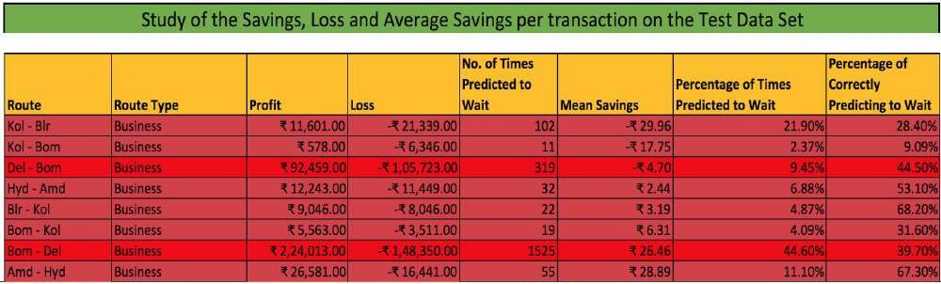

Slide 21
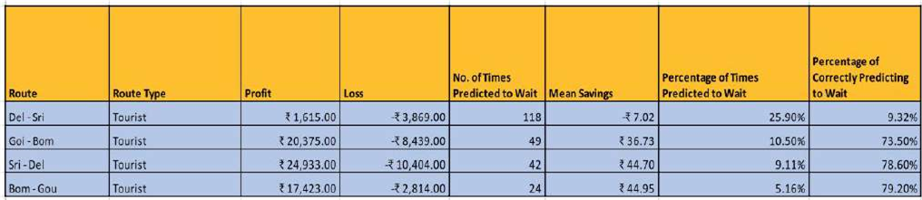

Slide 22
Conclusion Remarks from Exploratory Data Analysis
From the data collected and through exploratory data analysis, we can determine the following:
The trend of flight prices vary over various months and across the holiday.
There are two groups of airlines: the economical group and the luxurious group. Spicejet, AirAsia, IndiGo, Go Air are in the economical class, whereas Jet Airways and Air India in the other. Vistara has a more spread out trend.
The airfare varies depending on the time of departure, making timeslot used in analysis is an important parameter.
The airfare increases during a holiday season. In our time period, during Diwali the fare remained high for all the values of days to departure. We have considered holiday season as a parameter which helped in increasing the accuracy.

Slide 23
FUTURE WORK
More routes can be added and the same analysis can be expanded to major airports and travel routes in India.
The analysis can be done by increasing the data points and increasing the historical data used.
That will train the model better giving better accuracies and more savings.
More rules can be added in the Rule based learning based on our understanding of the industry, also incorporating the offer periods given by the airlines.
Developing a more user friendly interface for various routes giving more flexibility to the users.

Slide 24
References
O. Etzioni, R. Tuchinda, C. A. Knoblock, and A. Yates. To buy or not to buy: mining airfare data to minimize ticket purchase price.
Manolis Papadakis. Predicting Airfare Prices.
Groves and Gini, 2011. A Regression Model For Predicting Optimal Purchase Timing For Airline Tickets.
Modeling of United States Airline Fares – Using the Official Airline Guide (OAG) and Airline Origin and Destination Survey (DB1B), Krishna Rama-Murthy, 2006.
B. S. Everitt: The Cambridge Dictionary of Statistics​ ​, Cambridge University Press, Cambridge (3rd edition, 2006). ISBN 0-521-69027-7.
Bishop: Pattern Recognition and Machine Learning​ ​, Springer, ISBN 0-387-31073-8.
E. Bachis and C. A. Piga. Low-cost airlines and online price dispersion. International Journal of Industrial Organization, In Press, Corrected Proof, 2011.
P. P. Belobaba. Airline yield management. an overview of seat inventory control. Transportation Science, 21(2):63, 1987.

